Slide 1
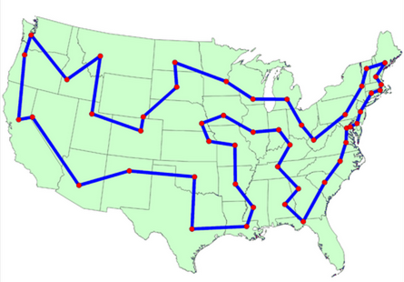
CS61B: 2020
Lecture 13: Introduction to Asymptotic Analysis
Intuitive Runtime
Detailed Analysis of Worst Case Order of Growth
Simplified Analysis
Big Theta Notation
Big O Notation

Slide 2
61B: Writing Efficient Programs
An engineer will do for a dime what any fool will do for a dollar.
Efficiency comes in two flavors:
Programming cost (course to date. Will also revisit later).
How long does it take to develop your programs?
How easy is it to read, modify, and maintain your code?
More important than you might think!
Majority of cost is in maintenance, not development!
Execution cost (from today until end of course).
How much time does your program take to execute?
How much memory does your program require?

Slide 3
Example of Algorithm Cost
Objective: Determine if a sorted array contains any duplicates.
Given sorted array A, are there indices i and j where A[i] = A[j]?
-3 | -1 | 2 | 4 | 4 | 8 | 10 | 12
Silly algorithm: Consider every possible pair, returning true if any match.
Are (-3, -1) the same? Are (-3, 2) the same? ...
Better algorithm?

Slide 4
Example of Algorithm Cost
Objective: Determine if a sorted array contains any duplicates.
Given sorted array A, are there indices i and j where A[i] = A[j]?
-3 | -1 | 2 | 4 | 4 | 8 | 10 | 12
Silly algorithm: Consider every possible pair, returning true if any match.
Are (-3, -1) the same? Are (-3, 2) the same? ...
Better algorithm?
For each number A[i], look at A[i+1], and return true the first time you see a match. If you run out of items, return false.
Today’s goal: Introduce formal technique for comparing algorithmic efficiency.

Slide 5
Intuitive Runtime Characterizations

Slide 6
How Do I Runtime Characterization?
Our goal is to somehow characterize the runtimes of the functions below.
Characterization should be simple and mathematically rigorous.
Characterization should demonstrate superiority of dup2 over dup1.
public static boolean dup1(int[] A) {
for (int i = 0; i < A.length; i += 1) {
for (int j = i + 1; j < A.length; j += 1) {
if (A[i] == A[j]) {
return true;
}
}
}
return false;
}
dup2
public static boolean dup2(int[] A) {
for (int i = 0; i < A.length - 1; i += 1) {
if (A[i] == A[i + 1]) {
return true;
}
}
return false;
}
dup1

Slide 7
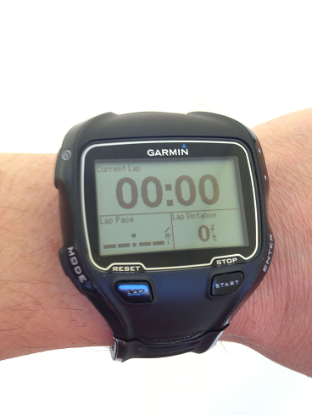
Techniques for Measuring Computational Cost
Technique 1: Measure execution time in seconds using a client program.
Tools:
Physical stopwatch.
Unix has a built in time command that measures execution time.
Princeton Standard library has a Stopwatch class.
public static void main(String[] args) {
int N = Integer.parseInt(args[0]);
int[] A = makeArray(N);
dup1(A);
}

Slide 8
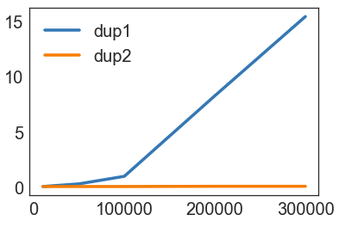
Time Measurements for dup1 and dup2
N | dup1 | dup2
10000 | 0.08 | 0.08
50000 | 0.32 | 0.08
100000 | 1.00 | 0.08
200000 | 8.26 | 0.1
400000 | 15.4 | 0.1
Time to complete (in seconds)

Slide 9
Techniques for Measuring Computational Cost
Technique 1: Measure execution time in seconds using a client program.
Good: Easy to measure, meaning is obvious.
Bad: May require large amounts of computation time. Result varies with machine, compiler, input data, etc.
public static void main(String[] args) {
int N = Integer.parseInt(args[0]);
int[] A = makeArray(N);
dup1(A);
}

Slide 10
Techniques for Measuring Computational Cost
Technique 2A: Count possible operations for an array of size N = 10,000.
Good: Machine independent. Input dependence captured in model.
Bad: Tedious to compute. Array size was arbitrary. Doesn’t tell you actual time.
for (int i = 0; i < A.length; i += 1) {
for (int j = i+1; j < A.length; j += 1) {
if (A[i] == A[j]) {
return true;
}
}
}
return false;
operation | count, N=10000
i = 0
j = i + 1
less than (<)
increment (+=1)
equals (==)
array accesses
1
1 to 10000
2 to 50,015,001
0 to 50,005,000
1 to 49,995,000
2 to 99,990,000
The counts are tricky to compute. Work not shown.

Slide 11
Techniques for Measuring Computational Cost
Technique 2B: Count possible operations in terms of input array size N.
Good: Machine independent. Input dependence captured in model. Tells you how algorithm scales.
Bad: Even more tedious to compute. Doesn’t tell you actual time.
for (int i = 0; i < A.length; i += 1) {
for (int j = i+1; j<A.length; j += 1) {
if (A[i] == A[j]) {
return true;
}
}
}
return false;
operation | symbolic count | count, N=10000
i = 0 | 1 | 1
j = i + 1 | 1 to N | 1 to 10000
less than (<) | 2 to (N²+3N+2)/2 | 2 to 50,015,001
increment (+=1) | 0 to (N²+N)/2 | 0 to 50,005,000
equals (==) | 1 to (N²-N)/2 | 1 to 49,995,000
array accesses | 2 to N²-N | 2 to 99,990,000

Slide 12
Techniques for Measuring Computational Cost [dup2]
Your turn: Try to come up with rough estimates for the symbolic and exact counts for at least one of the operations.
Tip: Don’t worry about being off by one. Just try to predict the rough magnitudes of each.
operation | sym. count | count, N=10000
i = 0 | 1 | 1
less than (<)
increment (+=1)
equals (==)
array accesses
for (int i = 0; i < A.length - 1; i += 1){
if (A[i] == A[i + 1]) {
return true;
}
}
return false;

Slide 13
Techniques for Measuring Computational Cost [dup2]
Your turn: Try to come up with rough estimates for the symbolic and exact counts for at least one of the operations.
for (int i = 0; i < A.length - 1; i += 1) {
if (A[i] == A[i + 1]) {
return true;
}
}
return false;
operation | symbolic count | count, N=10000
i = 0 | 1 | 1
less than (<) | 0 to N | 0 to 10000
increment (+=1) | 0 to N - 1 | 0 to 9999
equals (==) | 1 to N - 1 | 1 to 9999
array accesses | 2 to 2N - 2 | 2 to 19998
Especially observant folks may notice we didn’t count everything, e.g. “- 1” and “+ 1” operations. We’ll see why this omission is not a problem very shortly.
If you did this exercise but were off by one, that’s fine. The exact numbers aren’t that important.

Slide 14
Comparing Algorithms
Which algorithm is better? Why?
operation | symbolic count | count, N=10000
i = 0 | 1 | 1
j = i + 1 | 1 to N | 1 to 10000
less than (<) | 2 to (N²+3N+2)/2 | 2 to 50,015,001
increment (+=1) | 0 to (N²+N)/2 | 0 to 50,005,000
equals (==) | 1 to (N²-N)/2 | 1 to 49,995,000
array accesses | 2 to N²-N | 2 to 99,990,000
operation | symbolic count | count, N=10000
i = 0 | 1 | 1
less than (<) | 0 to N | 0 to 10000
increment (+=1) | 0 to N - 1 | 0 to 9999
equals (==) | 1 to N - 1 | 1 to 9999
array accesses | 2 to 2N - 2 | 2 to 19998
dup2
dup1

Slide 15
Comparing Algorithms
Which algorithm is better? dup2. Why?
Fewer operations to do the same work [e.g. 50,015,001 vs. 10000 operations].
Better answer: Algorithm scales better in the worst case. (N²+3N+2)/2 vs. N.
Even better answer: Parabolas (N²) grow faster than lines (N).
operation | symbolic count | count, N=10000
i = 0 | 1 | 1
j = i + 1 | 1 to N | 1 to 10000
less than (<) | 2 to (N²+3N+2)/2 | 2 to 50,015,001
increment (+=1) | 0 to (N²+N)/2 | 0 to 50,005,000
equals (==) | 1 to (N²-N)/2 | 1 to 49,995,000
array accesses | 2 to N²-N | 2 to 99,990,000
operation | symbolic count | count, N=10000
i = 0 | 1 | 1
less than (<) | 0 to N | 0 to 10000
increment (+=1) | 0 to N - 1 | 0 to 9999
equals (==) | 1 to N - 1 | 1 to 9999
array accesses | 2 to 2N - 2 | 2 to 19998
dup2
dup1

Slide 16
Asymptotic Behavior
In most cases, we care only about asymptotic behavior, i.e. what happens for very large N.
Simulation of billions of interacting particles.
Social network with billions of users.
Logging of billions of transactions.
Encoding of billions of bytes of video data.
Algorithms which scale well (e.g. look like lines) have better asymptotic runtime behavior than algorithms that scale relatively poorly (e.g. look like parabolas).

Slide 17
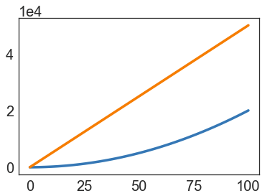
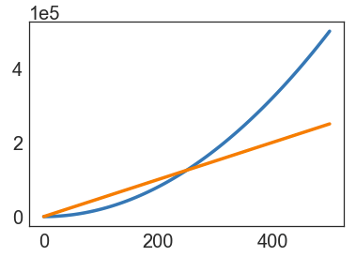
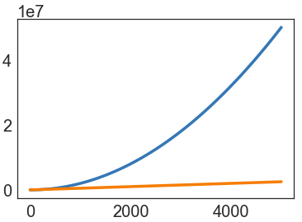
Parabolas vs. Lines
Suppose we have two algorithms that zerpify a collection of N items.
zerp1 takes 2N² operations.
zerp2 takes 500N operations.
For small N, zerp1 might be faster, but as dataset size grows, the parabolic algorithm is going to fall farther and farther behind (in time it takes to complete).

Slide 18
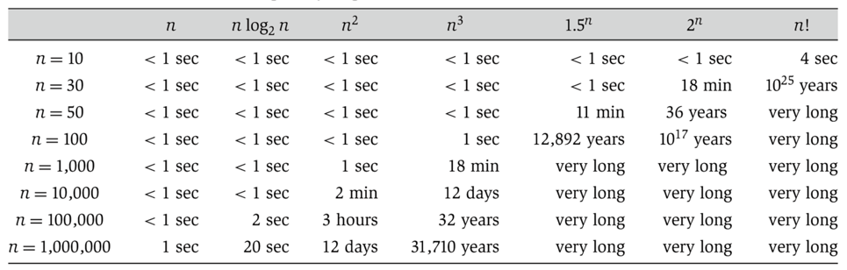

Scaling Across Many Domains
We’ll informally refer to the “shape” of a runtime function as its order of growth (will formalize soon).
Effect is dramatic! Often determines whether a problem can be solved at all.
(from Algorithm Design: Tardos, Kleinberg)

Slide 19


Duplicate Finding
Our goal is to somehow characterize the runtimes of the functions below.
Characterization should be simple and mathematically rigorous.
Characterization should demonstrate superiority of dup2 over dup1.
operation | symbolic count
i = 0 | 1
j = i + 1 | 1 to N
less than (<) | 2 to (N²+3N+2)/2
increment (+=1) | 0 to (N²+N)/2
equals (==) | 1 to (N²-N)/2
array accesses | 2 to N²-N
operation | symbolic count
i = 0 | 1
less than (<) | 0 to N
increment (+=1) | 0 to N - 1
equals (==) | 1 to N - 1
array accesses | 2 to 2N - 2
dup1: parabolic, a.k.a. quadratic
dup2: linear

Slide 20
Worst Case
Order of Growth

Slide 21
Duplicate Finding
Our goal is to somehow characterize the runtimes of the functions below.
Characterization should be simple and mathematically rigorous.
operation | count
i = 0 | 1
j = i + 1 | 1 to N
less than (<) | 2 to (N²+3N+2)/2
increment (+=1) | 0 to (N²+N)/2
equals (==) | 1 to (N²-N)/2
array accesses | 2 to N²-N
operation | count
i = 0 | 1
less than (<) | 0 to N
increment (+=1) | 0 to N - 1
equals (==) | 1 to N - 1
array accesses | 2 to 2N - 2
Let’s be more careful about what we mean when we say the left function is “like” a parabola, and the right function is “like” a line.

Slide 22
Intuitive Simplification 1: Consider Only the Worst Case
Simplification 1: Consider only the worst case.
operation | count
i = 0 | 1
j = i + 1 | 1 to N
less than (<) | 2 to (N²+3N+2)/2
increment (+=1) | 0 to (N²+N)/2
equals (==) | 1 to (N²-N)/2
array accesses | 2 to N²-N
for (int i = 0; i < A.length; i += 1) {
for (int j = i+1; j < A.length; j += 1) {
if (A[i] == A[j]) {
return true;
}
}
}
return false;

Slide 23
Intuitive Simplification 1: Consider Only the Worst Case
Simplification 1: Consider only the worst case.
Justification: When comparing algorithms, we often care only about the worst case [but we will see exceptions in this course].
operation | worst case count
i = 0 | 1
j = i + 1 | N
less than (<) | (N²+3N+2)/2
increment (+=1) | (N²+N)/2
equals (==) | (N²-N)/2
array accesses | N²-N
for (int i = 0; i < A.length; i += 1) {
for (int j = i+1; j < A.length; j += 1) {
if (A[i] == A[j]) {
return true;
}
}
}
return false;
We’re effectively focusing on the case where there are no duplicates, because this is where there is a performance difference.

Slide 24
Intuitive Order of Growth Identification: yellkey.com/carry
Consider the algorithm below. What do you expect will be the order of growth of the runtime for the algorithm?
N [linear]
N² [quadratic]
N³ [cubic]
N⁶ [sextic]
operation | count
less than (<) | 100N² + 3N
greater than (>) | 2N³ + 1
and (&&) | 5,000
In other words, if we plotted total runtime vs. N, what shape would we expect?

Slide 25
Intuitive Order of Growth Identification
Consider the algorithm below. What do you expect will be the order of growth of the runtime for the algorithm?
N³ [cubic]
operation | count
less than (<) | 100N² + 3N
greater than (>) | 2N³ + 1
and (&&) | 5,000
Argument:
Suppose < takes α nanoseconds, > takes β nanoseconds, and && takes γ nanoseconds.
Total time is α(100N² + 3N) + β(2N³ + 1) + 5000γ nanoseconds.
For very large N, the 2βN³ term is much larger than the others.
Extremely important point. Make sure you understand it!

Slide 26
Intuitive Simplification 2: Restrict Attention to One Operation
Simplification 2: Pick some representative operation to act as a proxy for the overall runtime.
Good choice: increment.
Bad choice: assignment of j = i + 1.
We call our choice the “cost model”.
There are other good choices.
operation | worst case count
i = 0 | 1
j = i + 1 | N
less than (<) | (N²+3N+2)/2
increment (+=1) | (N²+N)/2
equals (==) | (N²-N)/2
array accesses | N²-N
for (int i = 0; i < A.length; i += 1) {
for (int j = i+1; j < A.length; j += 1) {
if (A[i] == A[j]) {
return true;
}
}
}
return false;
cost model = increment

Slide 27
Intuitive Simplification 3: Eliminate low order terms.
Simplification 3: Ignore lower order terms.
for (int i = 0; i < A.length; i += 1) {
for (int j = i+1; j < A.length; j += 1) {
if (A[i] == A[j]) {
return true;
}
}
}
return false;
operation | worst case
increment (+=1) | (N²+N)/2

Slide 28
Intuitive Simplification 4: Eliminate multiplicative constants.
Simplification 4: Ignore multiplicative constants.
Why? It has no real meaning. We already threw away information when we chose a single proxy operation.
for (int i = 0; i < A.length; i += 1) {
for (int j = i+1; j < A.length; j += 1) {
if (A[i] == A[j]) {
return true;
}
}
}
return false;
operation | worst case
increment (+=1) | N²/2

Slide 29
Simplification Summary
Simplifications:
Only consider the worst case.
Pick a representative operation (a.k.a. the cost model).
Ignore lower order terms.
Ignore multiplicative constants.
operation | count
i = 0 | 1
j = i + 1 | 1 to N
less than (<) | 2 to (N²+3N+2)/2
increment (+=1) | 0 to (N²+N)/2
equals (==) | 1 to (N²-N)/2
array accesses | 2 to N²-N
These three simplifications are OK because we only care about the “order of growth” of the runtime.
operation | worst case o.o.g.
increment (+=1) | N²
Worst case order of growth of runtime: N²

Slide 30
Simplification Summary
Simplifications:
Only consider the worst case.
Pick a representative operation (a.k.a. the cost model).
Ignore lower order terms.
Ignore multiplicative constants.
operation | count
i = 0 | 1
less than (<) | 0 to N
increment (+=1) | 0 to N - 1
equals (==) | 1 to N - 1
array accesses | 2 to 2N - 2
These three simplifications are OK because we only care about the “order of growth” of the runtime.
operation | worst case o.o.g.
Worst case order of growth of runtime:

Slide 31
Repeating the Process for dup2
Simplifications:
Only consider the worst case.
Pick a representative operation (a.k.a. the cost model).
Ignore lower order terms.
Ignore multiplicative constants.
This simplification is OK because we specifically only care about worst case.
operation | count
i = 0 | 1
less than (<) | 0 to N
increment (+=1) | 0 to N - 1
equals (==) | 1 to N - 1
array accesses | 2 to 2N - 2
These three simplifications are OK because we only care about the “order of growth” of the runtime.
operation | worst case o.o.g.
array accesses | N
Worst case order of growth of runtime: N
Any of the bottom four operations are good choices.

Slide 32
Summary of Our (Painful) Analysis Process
Our process:
Construct a table of exact counts of all possible operations.
Convert table into a worst case order of growth using 4 simplifications.
By using our simplifications from the outset, we can avoid building the table at all!
operation | count
i = 0 | 1
j = i + 1 | 1 to N
less than (<) | 2 to (N²+3N+2)/2
increment (+=1) | 0 to (N²+N)/2
equals (==) | 1 to (N²-N)/2
array accesses | 2 to N²-N
operation | worst case o.o.g.
increment (+=1) | N²
Worst case order of growth of runtime: N²

Slide 33
Simplified Analysis

Slide 34
Simplified Analysis Process
Rather than building the entire table, we can instead:
Choose a representative operation to count (a.k.a. cost model).
Figure out the order of growth for the count of the representative operation by either:
Making an exact count, then discarding the unnecessary pieces.
Using intuition and inspection to determine order of growth (only possible with lots of practice).
Let’s redo our analysis of dup1 with this new process.
This time, we’ll show all our work.

Slide 35
Analysis of Nested For Loops (Based on Exact Count)
Find the order of growth of the worst case runtime of dup1.
N = 6
int N = A.length;
for (int i = 0; i < N; i += 1)
for (int j = i + 1; j < N; j += 1)
if (A[i] == A[j])
return true;
return false;
0
1
2
3
4
5
 | == | == | == | == | ==
 |  | == | == | == | ==
 |  |  | == | == | ==
 |  |  |  | == | ==
 |  |  |  |  | ==
i
Worst case number of == operations:
C = 1 + 2 + 3 + … + (N - 3) + (N - 2) + (N - 1)
0 1 2 3 4 5
C = (N - 1) + (N - 2) + (N - 3) + … + 3 + 2 + 1
j
2C = N + N + … + N
= N(N - 1)
N-1 of these
∴ C = N(N - 1)/2
Overall worst case runtime: Θ(N²)

Slide 36
Analysis of Nested For Loops (Based on Exact Count)
Find the order of growth of the worst case runtime of dup1.
N = 6
int N = A.length;
for (int i = 0; i < N; i += 1)
for (int j = i + 1; j < N; j += 1)
if (A[i] == A[j])
return true;
return false;
0
1
2
3
4
5
 | == | == | == | == | ==
 |  | == | == | == | ==
 |  |  | == | == | ==
 |  |  |  | == | ==
 |  |  |  |  | ==
i
Worst case number of == operations:
C = 1 + 2 + 3 + … + (N - 3) + (N - 2) + (N - 1) = N(N-1)/2
0 1 2 3 4 5
j
operation | worst case o.o.g.
== | N²
Worst case order of growth of runtime: N²
Overall worst case runtime: Θ(N²)

Slide 37
Analysis of Nested For Loops (Simpler Geometric Argument)
Find the order of growth of the worst case runtime of dup1.
N = 6
int N = A.length;
for (int i = 0; i < N; i += 1)
for (int j = i + 1; j < N; j += 1)
if (A[i] == A[j])
return true;
return false;
0
1
2
3
4
5
 | == | == | == | == | ==
 |  | == | == | == | ==
 |  |  | == | == | ==
 |  |  |  | == | ==
 |  |  |  |  | ==
i
Worst case number of == operations:
Given by area of right triangle of side length N-1.
Order of growth of area is N².
0 1 2 3 4 5
j
operation | worst case o.o.g.
== | N²
Worst case order of growth of runtime: N²
Overall worst case runtime: Θ(N²)

Slide 38
Big-Theta

Slide 39
Formalizing Order of Growth
Given a function Q(N), we can apply our last two simplifications (ignore low orders terms and multiplicative constants) to yield the order of growth of Q(N).
Example: Q(N) = 3N³ + N²
Order of growth: N³
Let’s finish out this lecture by moving to a more formal notation called Big-Theta.
The math might seem daunting at first.
… but the idea is exactly the same! Using “Big-Theta” instead of “order of growth” does not change the way we analyze code at all.

Slide 40
Order of Growth Exercise
Consider the functions below.
Informally, what is the “shape” of each function for very large N?
In other words, what is the order of growth of each function?
function | order of growth
N³ + 3N⁴
1/N + N³
1/N + 5
Ne^{N} + N
40 sin(N) + 4N²

Slide 41
Order of Growth Exercise
Consider the functions below.
Informally, what is the “shape” of each function for very large N?
In other words, what is the order of growth of each function?
function | order of growth
N³ + 3N⁴ | N⁴
1/N + N³ | N³
1/N + 5 | 1
Ne^{N} + N | Ne^{N}
40 sin(N) + 4N² | N²

Slide 42
Big-Theta
Suppose we have a function R(N) with order of growth f(N).
In “Big-Theta” notation we write this as R(N) ∈ Θ(f(N)).
Examples:
N³ + 3N⁴ ∈ Θ(N⁴)
1/N + N³ ∈ Θ(N³)
1/N + 5 ∈ Θ(1)
Ne^{N} + N ∈ Θ(Ne^{N})
40 sin(N) + 4N² ∈ Θ(N²)
function R(N) | order of growth
N³ + 3N⁴ | N⁴
1/N + N³ | N³
1/N + 5 | 1
Ne^{N} + N | Ne^{N}
40 sin(N) + 4N² | N²

Slide 43
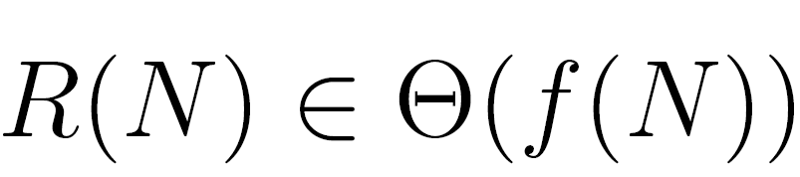
Big-Theta: Formal Definition (Visualization)
means there exist positive constants k₁ and k₂ such that:
for all values of N greater than some N₀.
i.e. very large N
Example: 40 sin(N) + 4N² ∈ Θ(N²)
R(N) = 40 sin(N) + 4N²
f(N) = N²
k1 = 3
k2 = 5

Slide 44
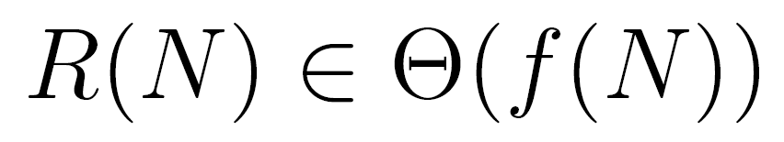
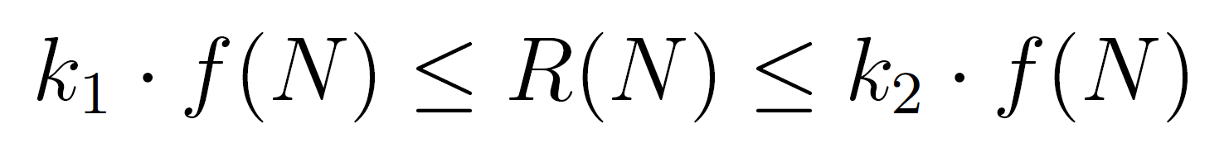
Big-Theta Challenge (Visualization)
Suppose R(N) = (4N²+3N*ln(N))/2.
Find a simple f(N) and corresponding k₁ and k₂.
means there exist positive constants k₁ and k₂ such that:
for all values of N greater than some N₀.
i.e. very large N

Slide 45
Big-Theta Challenge (Visualization)
Suppose R(N) = (4N²+3N*ln(N))/2.
f(N) = N²
k₁ = 1
k₂ = 3
means there exist positive constants k₁ and k₂ such that:
for all values of N greater than some N₀.
i.e. very large N

Slide 46
Big-Theta and Runtime Analysis
Using Big-Theta doesn’t change anything about runtime analysis (no need to find k₁ or k₂ or anything like that).
The only difference is that we use the Θ symbol anywhere we would have said “order of growth”.
operation | worst case count
i = 0 | 1
j = i + 1 | Θ(N)
less than (<) | Θ(N²)
increment (+=1) | Θ(N²)
equals (==) | Θ(N²)
array accesses | Θ(N²)
operation | worst case count
increment (+=1) | Θ(N²)
Worst case runtime: Θ(N²)

Slide 47
Big O Notation

Slide 48
Big Theta
We used Big Theta to describe the order of growth of a function.
We also used Big Theta to describe the rate of growth of the runtime of a piece of code.
function R(N) | order of growth
N³ + 3N⁴ | Θ(N⁴)
1/N + N³ | Θ(N³)
1/N + 5 | Θ(1)
Ne^{N} + N | Θ(Ne^{N})
40 sin(N) + 4N² | Θ(N²)

Slide 49
Big O
Whereas Big Theta can informally be thought of as something like “equals”, Big O can be thought of as “less than or equal”.
Example, the following are all true:
N³ + 3N⁴ ∈ Θ(N⁴)
N³ + 3N⁴ ∈ O(N⁴)
N³ + 3N⁴ ∈ O(N⁶)
N³ + 3N⁴ ∈ O(N!)
N³ + 3N⁴ ∈ O(N^{N!})

Slide 50
Big Theta: Formal Definition (Visualization)
means there exist positive constants k₁ and k₂ such that:
for all values of N greater than some N₀.
i.e. very large N
Example: 40 sin(N) + 4N² ∈ Θ(N²)
R(N) = 40 sin(N) + 4N²
f(N) = N²
k1 = 3
k2 = 5

Slide 51
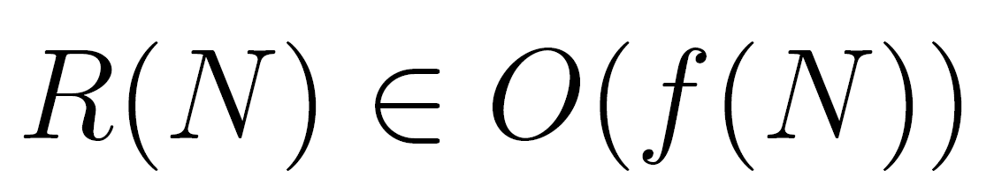
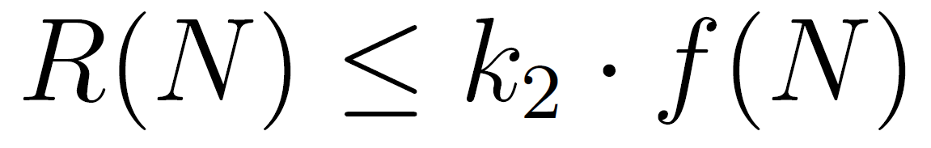
Big O: Formal Definition (Visualization)
means there exists positive constants k₂ such that:
for all values of N greater than some N₀.
i.e. very large N
Example: 40 sin(N) + 4N² ∈ O(N⁴)
R(N) = 40 sin(N) + 4N²
f(N) = N⁴
k2 = 1

Slide 52
Big Theta vs. Big O
 | Informal meaning: | Family | Family Members
Big Theta Θ(f(N)) | Order of growth is f(N). | Θ(N²) | N²/2 2N² N² + 38N + N
Big O O(f(N)) | Order of growth is less than or equal to f(N). | O(N²) | N²/2 2N² lg(N)
We will see why big O is practically useful in the next lecture.

Slide 53
Summary
Given a code snippet, we can express its runtime as a function R(N), where N is some property of the input of the function (often the size of the input).
Rather than finding R(N) exactly, we instead usually only care about the order of growth of R(N).
One approach (not universal):
Choose a representative operation, and let C(N) be the count of how many times that operation occurs as a function of N.
Determine order of growth f(N) for C(N), i.e. C(N) ∈ Θ(f(N))
Often (but not always) we consider the worst case count.
If operation takes constant time, then R(N) ∈ Θ(f(N))
Can use O as an alternative for Θ. O is used for upper bounds.

Slide 54
Citations
TSP problem solution, title slide: http://support.sas.com/documentation/cdl/en/ornoaug/65289/HTML/default/viewer.htm#ornoaug_optnet_examples07.htm#ornoaug.optnet.map002g
Table of runtimes for various orders of growth: Kleinberg & Tardos, Algorithm Design.

